Slide 1

Teaching Adult Learners
Presented by: Yvette Dupree
Notes:
Shortened version of a presentation given on adult learning

Slide 2


Characteristics of Adult Learners
Experienced and knowledgeable
Established values, beliefs, and opinions
Results-oriented
Problem-centered
Self-directed
Skeptical
Notes:
Make your purpose clear
increased variation in learning styles
Expect to be treated as adults
Experienced and knowledgeable
Established values, beliefs, and opinions
Interested in straightforward how-to
Problem-centered approach to learning
Self-directed learners
Interested in straightforward how-to
they are more self-guided in their learning
they bring more, and expect to bring more, to a learning situation because of their wider experience - and can take more away
they require learning "to make sense" - they will not perform a learning activity just because the instructor said to do it

Slide 3

Activity
Notes:
Visual and Auditory Learner Activity

Slide 4

Adult Learning Styles
Learning Styles | Characteristics | Teaching Strategies
Visual | Visual illustrations or demonstrations | Graphics & illustrations Images Demonstrations
Auditory | Speaking, repetition | Lectures Discussions Podcasts
Kinesthetic | Touch or manipulation of objects | Note taking Examination of objects Participation in activities
Notes:
Environmental
Surroundings that match learner preferences (room temperature, lighting, seating, etc.)
online learning

Slide 5



Presentations
Classic
Trending
Power Point
Print Articles
Lecture
Overheads
DVDs
Email
Prezi
Blogs
Debate
Projectors
Podcasts
Tweets & Posts
Notes:
There are many ways to reach adult learners , classic and new methods can be used.

Slide 6


Teaching Strategies
Use participants as resources
Encourage debate and discussion
Address multiple learning styles
Utilize different teaching methods
Be respectful
Engage

Slide 7
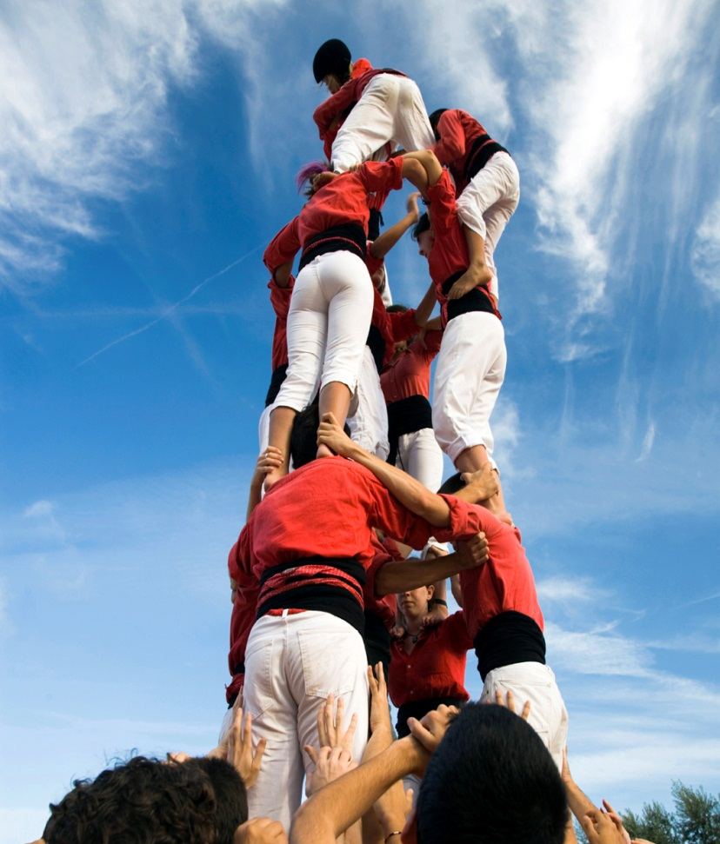
Remember
Passion
Purpose
Clarity
Simplicity
Collaboration

Slide 8


Questions?

